Slide 1
OOP Lab - Week 1
Group 30224

Slide 2
Ing. Ana-Maria Naneș
Software Engineer @ Betfair
Teaching Assistant @ Technical University of Cluj-Napoca (OOP, DSA, TP)
Master Student Graduate
Ana.Nanes@cs.utcluj.ro / anamaria.nanes@yahoo.com

Slide 3
Platforms
Teams
for online laboratory sessions.
Moodle (Use the lab Enrollment Key)
laboratory and course materials
assignments submissions
Github
additional laboratory materials
assignments submissions
code review
version control

Slide 4
Laboratory Participation
Mandatory
If you are not able to participate with your group, you should have the laboratory session with another group in the same week

Slide 5
Laboratory Requirements & Grading
2 laboratory test
optional mini project (+1p) - highly recommended !!
Passing grade >=5

Slide 6

Github
Create an account
Create a private repository for the OOP laboratory
Add me as a contributor (Settings-> Manage Access -> Invite collaborators -> add) AnaMariaNanes
Clone the repository on your computer
Add all your work on the repository and track versions and changes

Slide 7

GIT commands
Git clone
Git gui
Git add .
Git commit -m “commit message”
Git push origin master
Git status
To learn more, pass the Git game levels:
https://learngitbranching.js.org/

Slide 8

GIT in IntelliJ
In IntelliJ Terminal
git gui command
Choose the modified files to commit
Create new commit or amend last commit
Always add a commit message
git push origin master

Slide 9
.gitignore file
specifies intentionally untracked files that Git should ignore
each line in a gitignore file specifies a pattern
For the assignments, commit only the source file and the configuration files !!

Slide 10
People Program
MainClass: the main method with command line arguments, here we instantiate classes (create objects).
Database: a class that acts as a database, storing a list of Persons
Person: an abstract class that models a person (name & yearOfBirth)
Staff: a special type of person (it also has a room associated)
Student: a special type of person (it also has a SID associated)

Slide 11

Debugging in IntelliJ
useful to identify problems faster
better than printing intermediate results
Set breakpoints and check values of objects and variables

Slide 12
JavaDoc
Use the special type of comments /** **/
ALT + ENTER on the name of the class/ method
Tools -> Generate JavaDoc

Slide 13
Command line arguments
Run -> Edit Configurations -> Application -> Select Main class & enter Program arguments
public static void main(String args[]) {
for(int i = 0; i<args.length; i++) {
System.out.println("args[" + i + "]: " + args[i]);
}

Slide 14
JAVA_HOME Path variable
Install Java version 17
JDK should be installed in: C:\Program Files\Java
This PC -> Properties -> Advanced System Settings -> Environment Variables -> New
Add new variable:
Variable name: JAVA_HOME
Variable path: C:\Program Files\Java\jdk1.8.0_191 (the jdk version installed)
Edit the PATH variable -> add %JAVA_HOME%\bin
To test in cmd: java -version

Slide 15
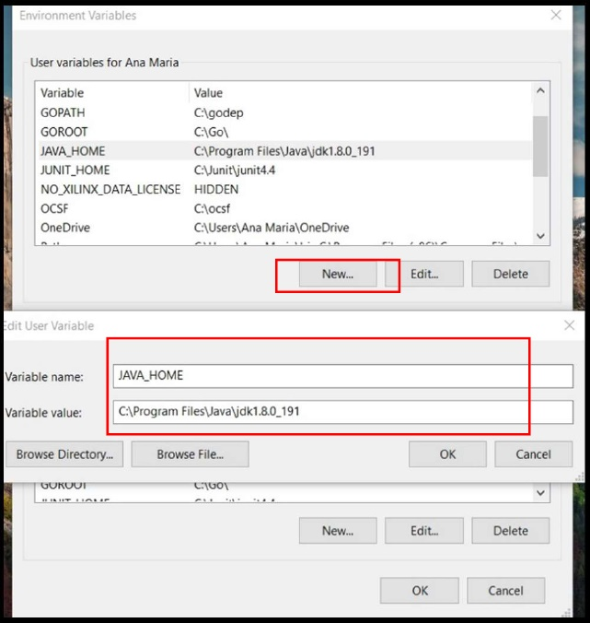
JAVA_HOME Path variable

Slide 16
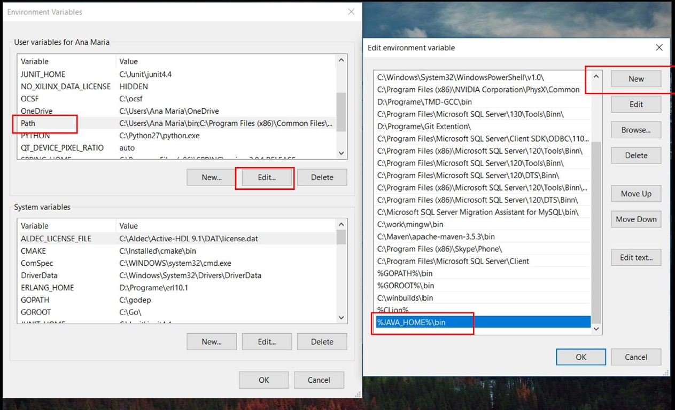
JAVA_HOME Path variable

Slide 17
Compiling and Running from CMD
Open the cmd in the project’s folder
Compile: javac MainClass.java
Run: java MainClass

Slide 18
Creating and running a jar
Jar = Java ARchive ()
File -> Project Structure -> Artifacts -> + Jar -> From module with dependencies -> Choose the main class
Build -> Build Artifacts -> People.jar
Find the jar in out/artifacts
Running the jar:
java -jar People.jar

Slide 19
Useful resources
https://docs.oracle.com/en/java/javase/14/
https://stackoverflow.com/
https://www.baeldung.com/java-tutorial

